Slide 1

The 2nd WCRP CORDEX Science and Training Workshop
27-30,August 2013
Terrestrial Ecosystem Carbon and Climate Change
Devaraju N
Indian Institute of Science, Bangalore, India
dev@caos.iisc.ernet.in

Slide 2
Outline
Interactions between terrestrial ecosystem carbon
and climate
Introduction to DATA Analysis using CDAT

Slide 3
Vegetation <--> Atmosphere interactions
Different Climate States ?

Slide 4
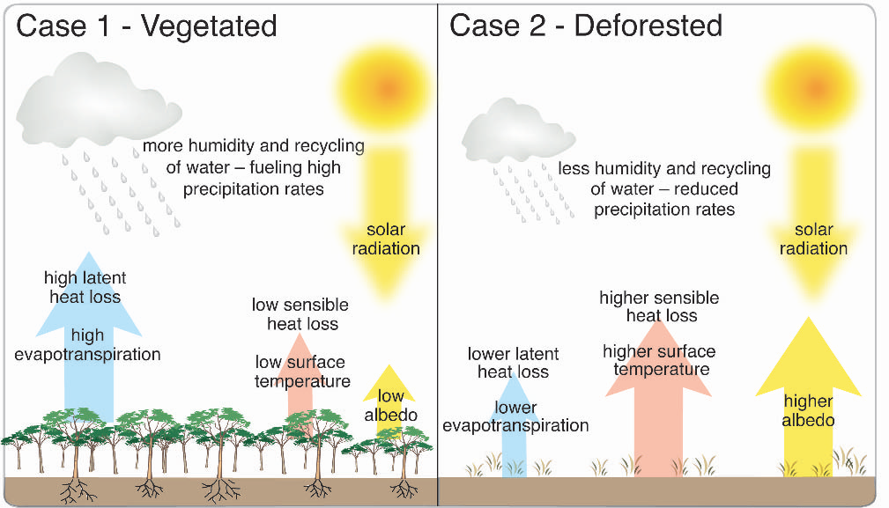
Vegetation
Deforestation

Slide 5
Literature
Brovkin et al 2003 found one steady state in northern high latitudes (abrupt vegetation change due to delayed response)
Bistable steady states found in Amazon(drier) by Oyama and Nobre 2003 (environmental degradation)
Kleidon et al 2007 claim that the occurrence of multiple steady states could be a model artifact

Slide 6
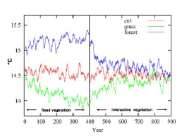
Brovkin et. al. 2009 found an absence of multiple states

Slide 7
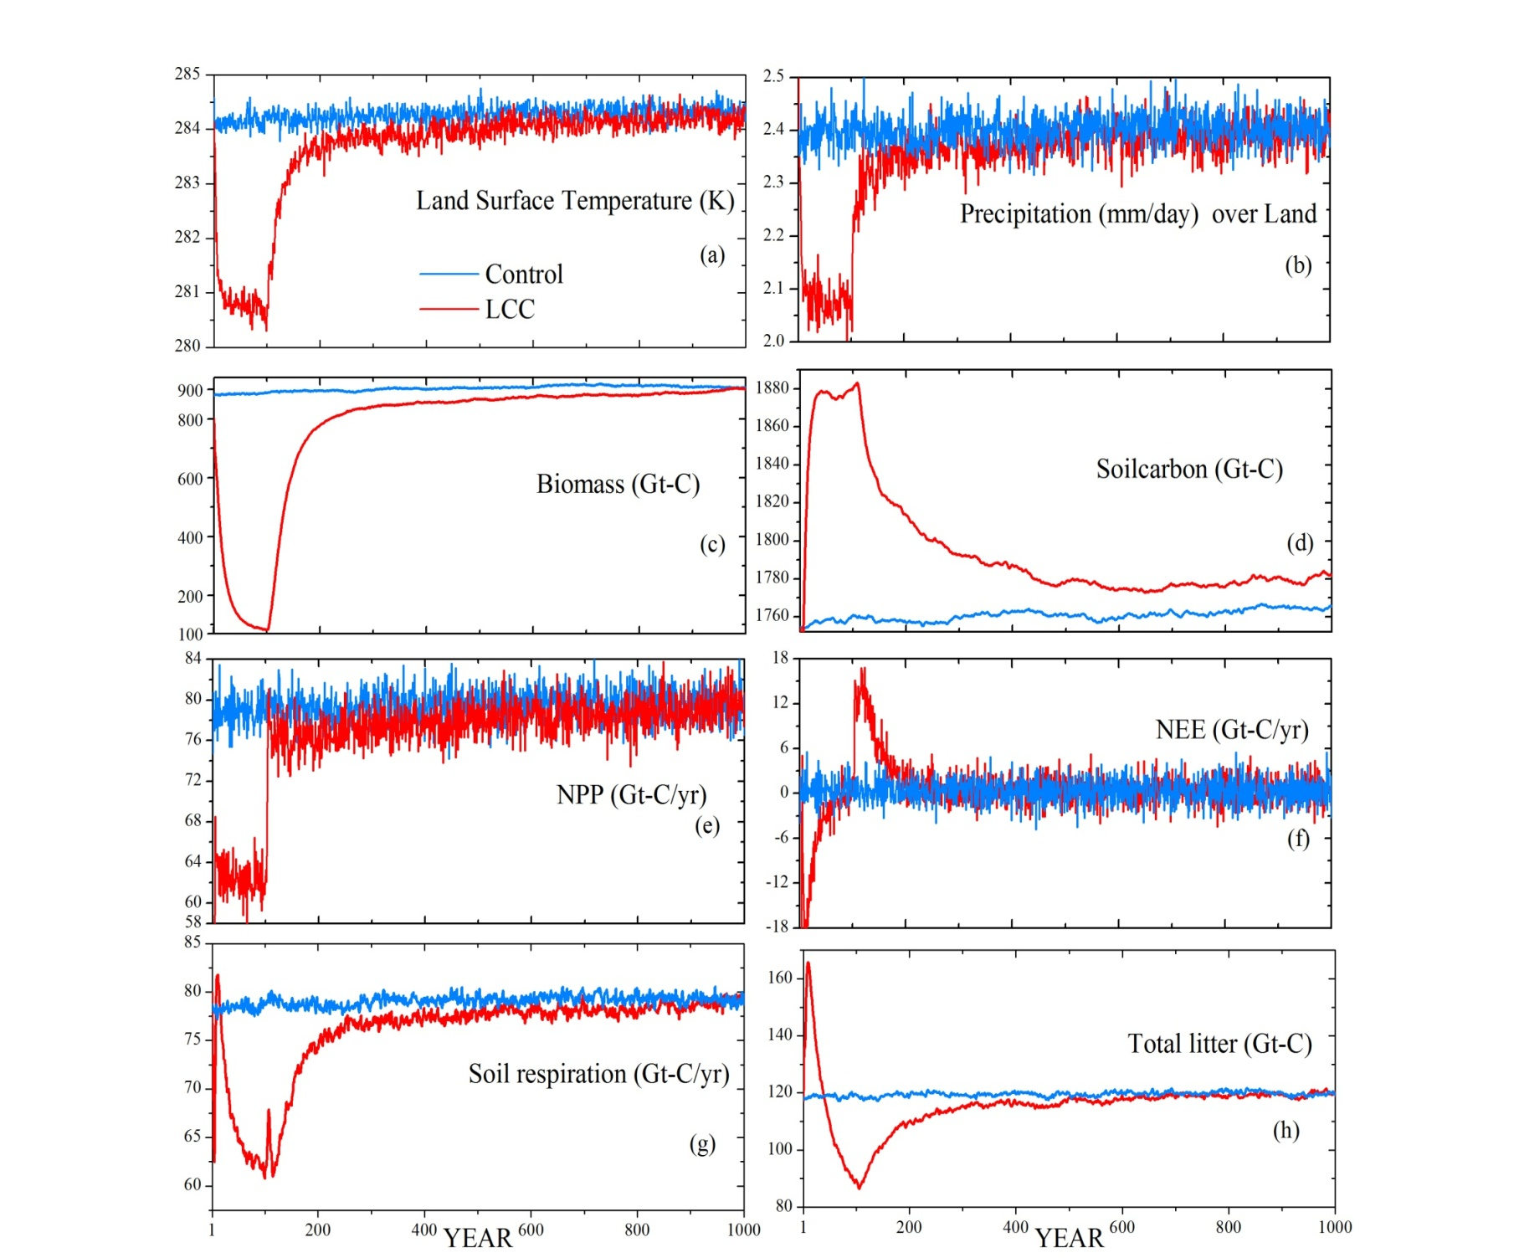
Devaraju et. al. 2011 Also found an absence of multiple states
0.35mm/day
3K

Slide 8
Uncertainties in Multiple Climate States
Due to Interactions between the systems
* Carbon cycle
* Carbon-Nitrogen Cycle interactions (CLM4-CN)
* Carbon-Nitrogen-Phosphorous Cycle

Slide 9
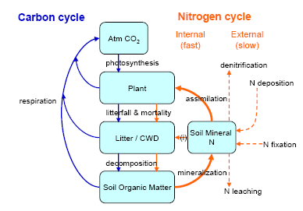
Example
CLM4-C
CLM4CN

Slide 10
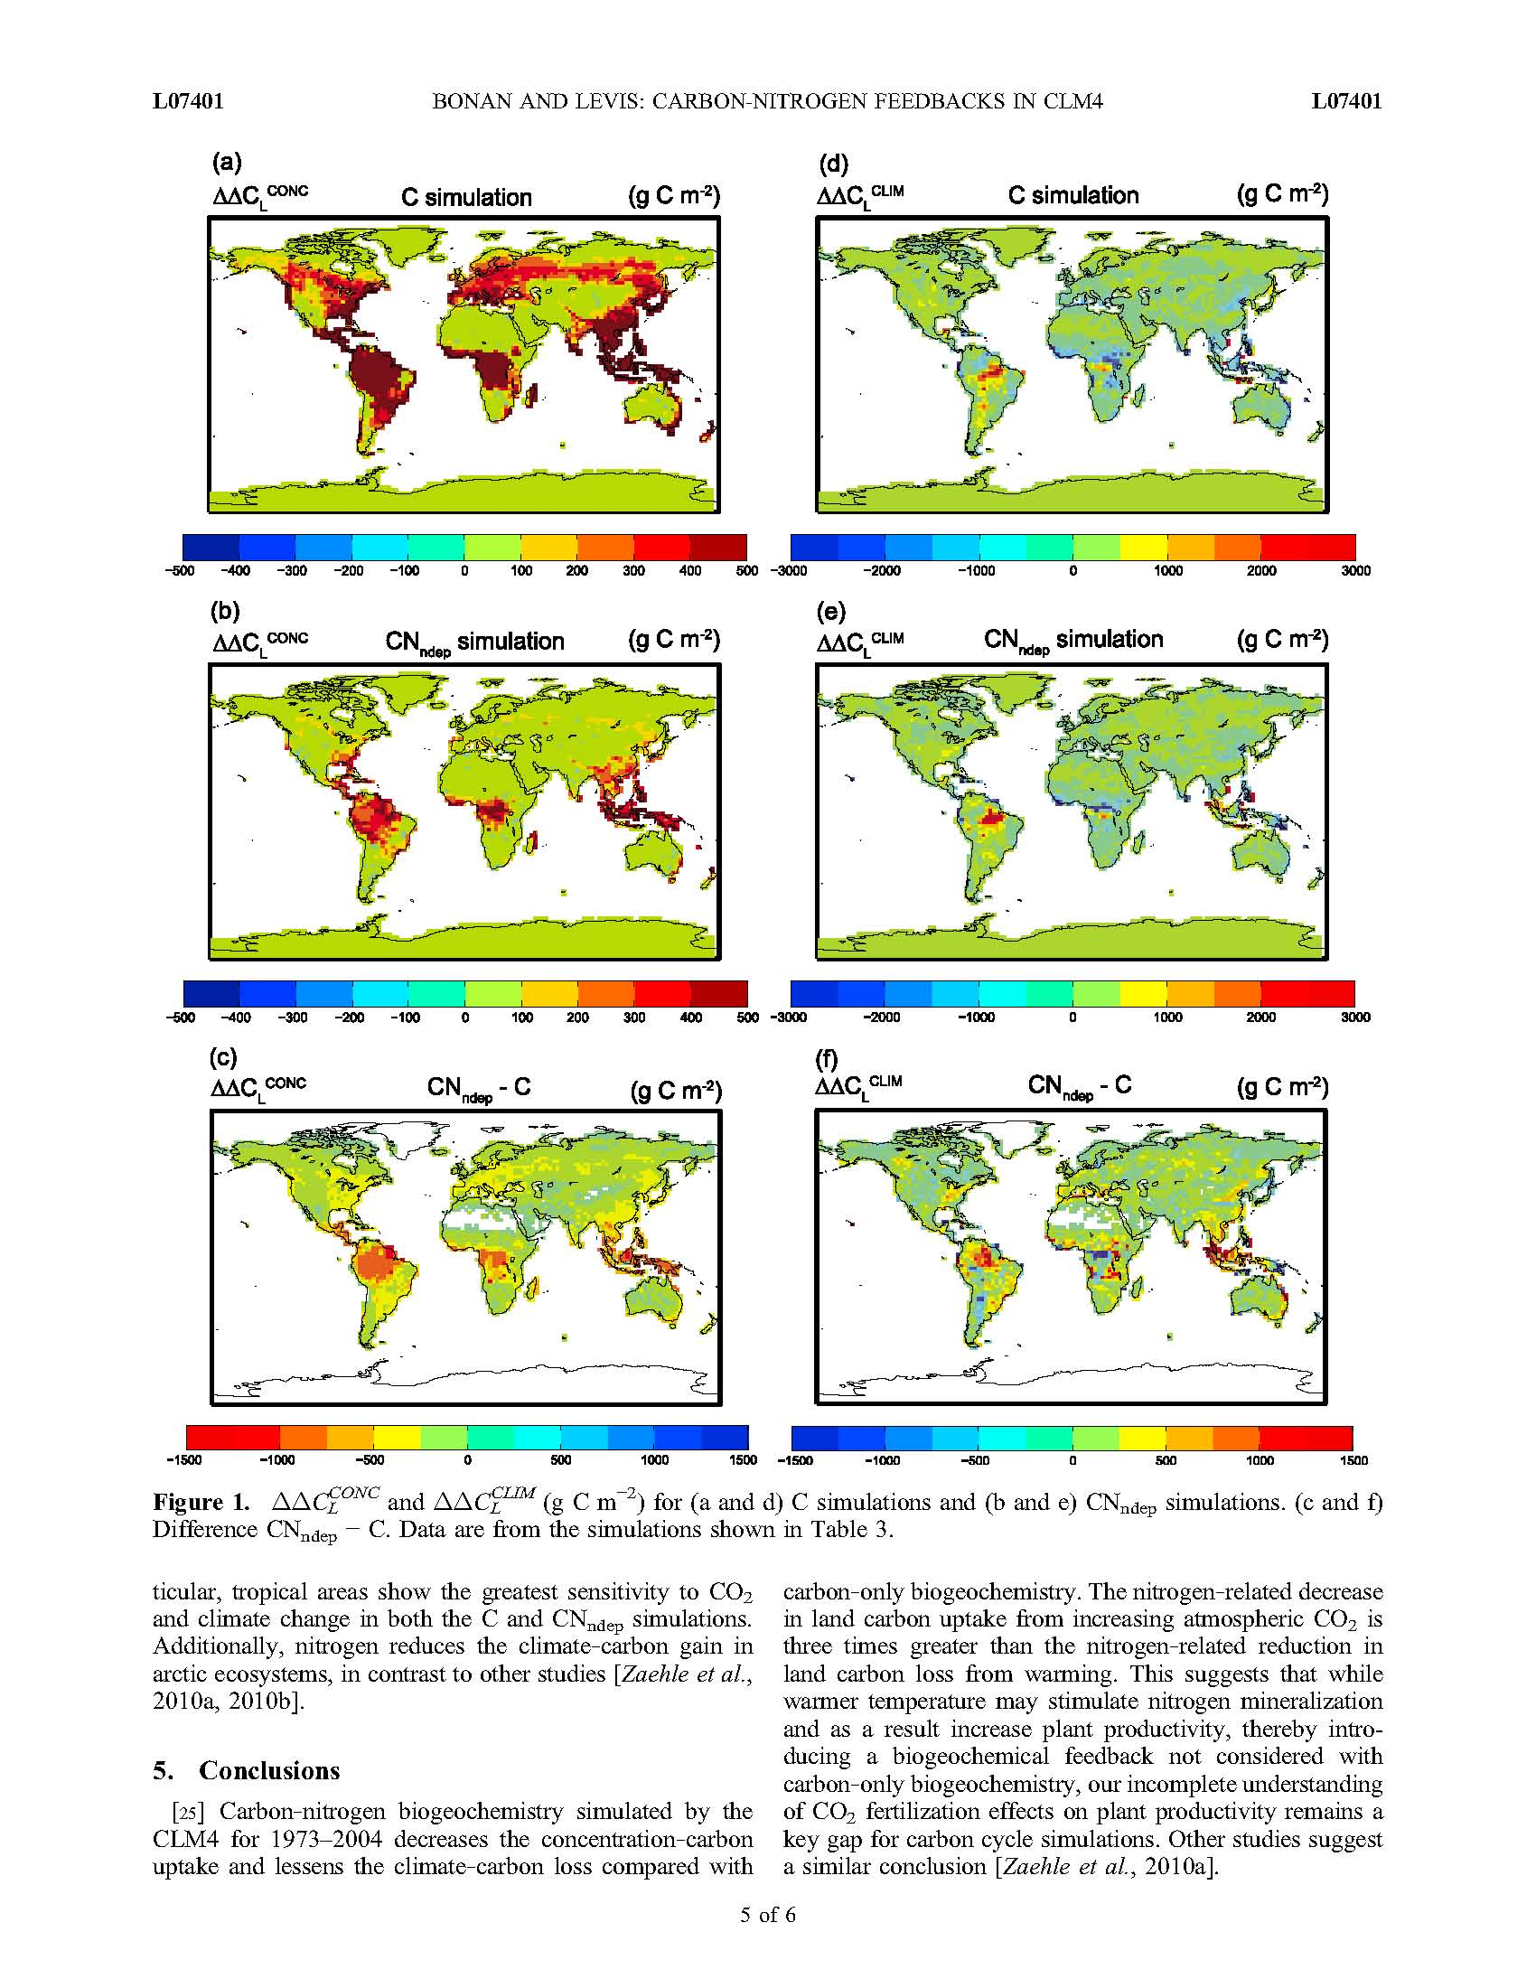
Carbon only models overestimate the ecosystem carbon

Slide 11
CLM4CN Results (Bonan and Levis 2010, GRL)
The C and CNdep carbon budgets for 1973-2004 are consistent with earlier studies.
In the carbon-only simulation
32 year mean Land use emission 1.8PgCyr-1
Land sink 2.5PgCyr-1
In the CN deposition simulation
32 year mean Land use emission 1.8PgCyr-1
Land sink 1.8PgCyr-1

Slide 12
The uptake and release of the carbon through the
process of photosynthesis and
respiration plays a significant role in determining
the fraction of anthropogenic CO2 that stays in the
atmosphere and changes in climate.
In order to improve our understanding of the
historical changes and predict future trends in
ecosystems:
We must improve our understanding of individual
ecosystem processes and their interactions.

Slide 13
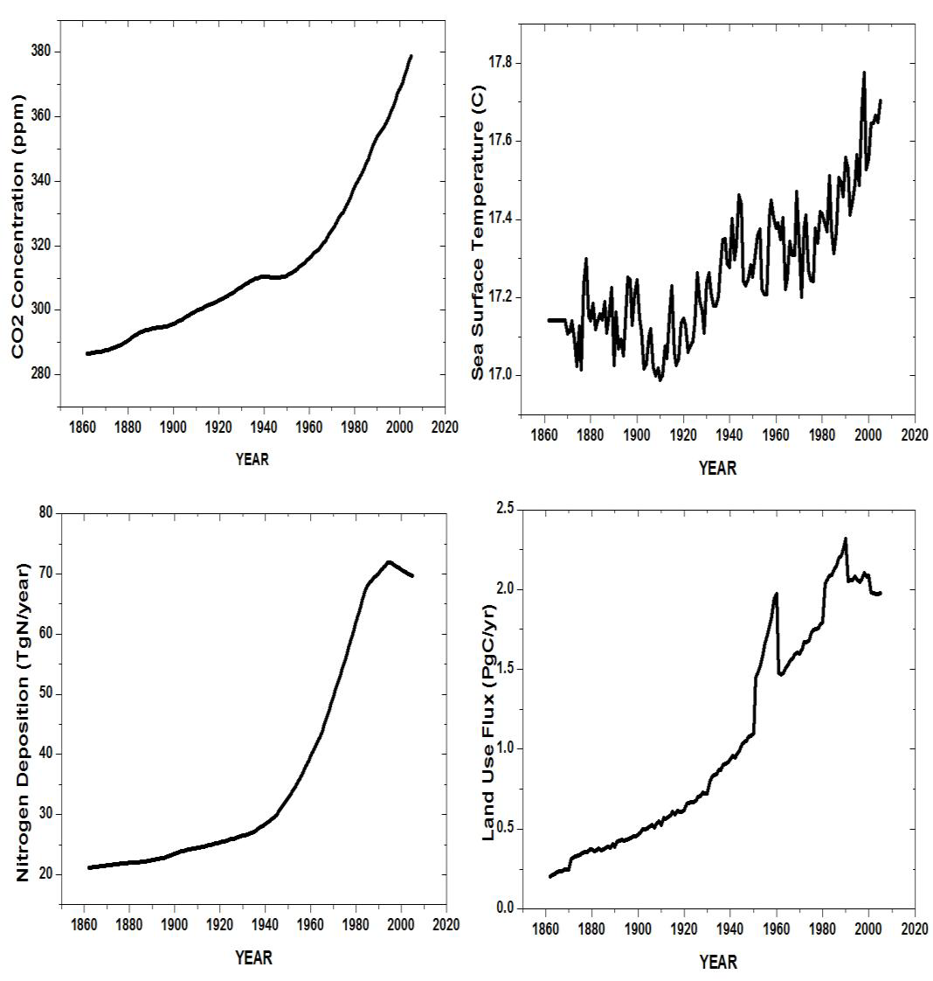

Slide 14
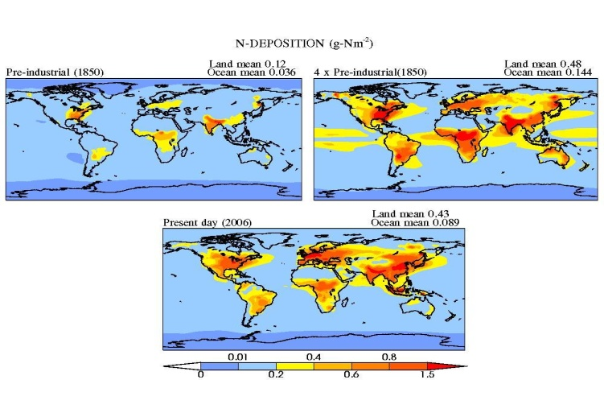

CLM4 N-deposition
0.12 gN/m2 (~20 Tg-N/yr)
Galloway et. al. 2004,2008 says
Humans have more than doubled
the rate at which nitrogen enters the
terrestrial biosphere
Agricultural land expansion,
Fossil fuel burning and
Fertilization application
0.43 gN/m2 (~73.1 Tg-N/yr)
Thus, Earth’s vegetation cover affects significantly
Alter regional and global climate through
changes in the global carbon and nitrogen cycles
To date, very few global scale studies exist
on the impact of elevated nitrogen deposition
on terrestrial ecosystem

Slide 15
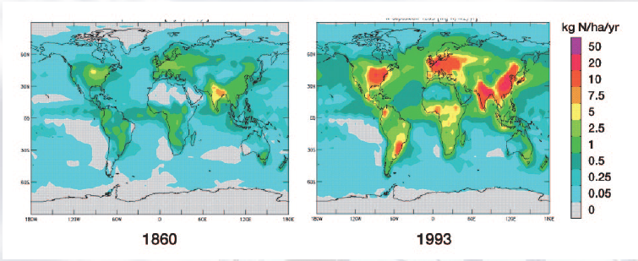
Spatial pattern of Total inorganic N deposition.
(Source: Lelieveld and Dentener 2000; Galloway et al 2004)

Slide 16
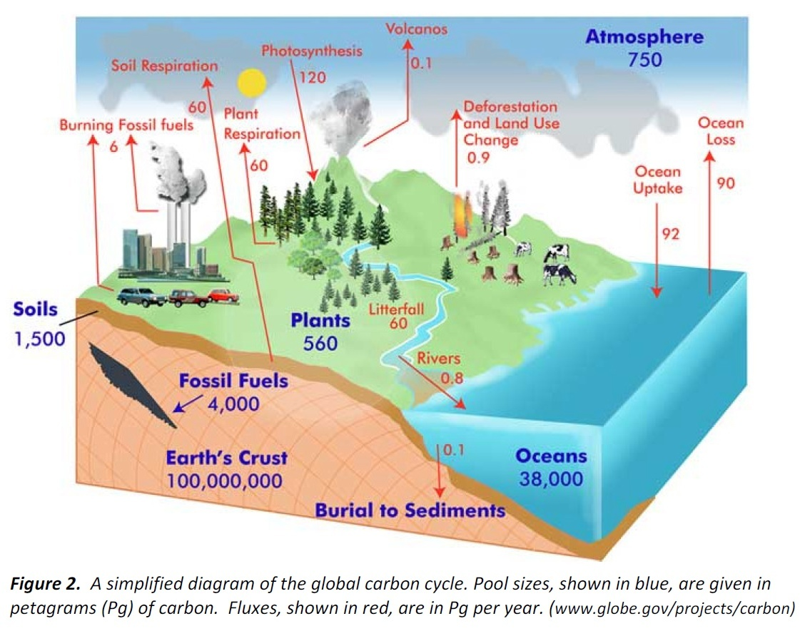
Stocks in blue in Peta grams (PgC)
Fluxes in red (PgC/year)
Carbon is the basis of life on Earth

Slide 17
If all sources are equal to all sinks, the carbon cycle can
be said to be in equilibrium (or in balance)
However, because fossil fuel combustion and
deforestation have changed the terrestrial stocks
Increasing the CO₂ inputs to the atmosphere, these
activities have caused the size of the atmospheric carbon
pool to increase and is believed to cause the observed
trend of increasing global temperatures.

Slide 18
Missing Sink (Esser et al 2011)
Fossi fuel emission 343 PgC
LULCC 156 PgC
Total 499 (since pre-industrial)
In the atmosphere 216 PgC
Uptake ocean 118 PgC
Total 334 PgC
Difference (499 -334) = 165 PgC (missing sink)

Slide 19
Stocks:
Terrestrial ecosystem carbon
The few variables which describes the Carbon cycle in the modeels
The major reservoirs of terrestrial carbon are:
  Total Vegetation Carbon (TOTVEGC) which as the name suggests is the carbon
  stored in plants or biomass and accounts for about 560 PgC stored
  Soil Carbon (SOILC) is the largest pool of terrestrial carbon (1500 PgC)

Slide 20
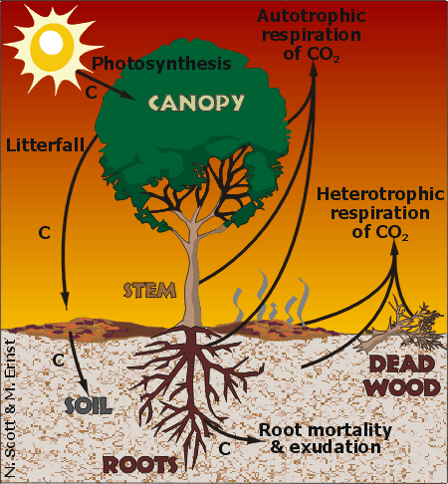
FLUXES (gC/m^2/s)
C is exchanged naturally between the terrestrial systems and the atmosphere mainly through photosynthesis and respiration
Some of the flux related terms are :
Autotrophic Respiration: respiration processes by living plant parts
Heterotrophic respiration: respiration processes by microbes in soil and litter
Net Primary Productivity (NPP) is the difference between photosynthesis and plant respiration
Net Ecosystem Exchange (NEE) is the net carbon movement between an ecosystem and the atmosphere

Slide 21
Hands on Training Session

Slide 22
Model Description for CLM4 of NCAR
(Community Land Model version4)
The CLM4 examines the physical, chemical, and biological processes of terrestrial ecosystem and demonstrates the importance of climate in determining vegetation compositions and the feedback.
http://www.cesm.ucar.edu/models/ccsm4.0/clm/models/lnd/clm/doc/UsersGuide/f63.html
1000-year experiments (Net ecosystem exchange is nearly zero by 900)
A horizontal resolution of 1.9° latitude and 2.5° longitude is used. A 57-year (1948–2004) observational atmospheric forcing dataset is used to drive the model.
CTL (Pre-industrial N-deposition)
CTL2K
CTL2xCO2
4N

Slide 23
DATA
Global CLM4 simulations with 2 deg resolution
CTL, 4Ndep, 2Kwatming, 2xco2
Compute NPP, SOILC, VEGC and TOTECO SYSC due to N deposition, CO2 increase, Warming
Global CAM5 simulations with 2 deg resolution
CTL, LCC
Compute the Change in Temperature & Precipitation due to Land cover change.

Slide 24
OUT PUT DATA FORMAT of CLM4 and CAM5
NetCDF (Network Common Data Format)
Create
Edit
Modify Variables

Slide 25
Tools
For spatial plots
CDAT (NCL, Matlab, ferret etc..) OS:Linux
It is a collection of python modules
Scripting is python (.py)
Visualization is also possible for quick check of the data: VCDAT

Slide 26
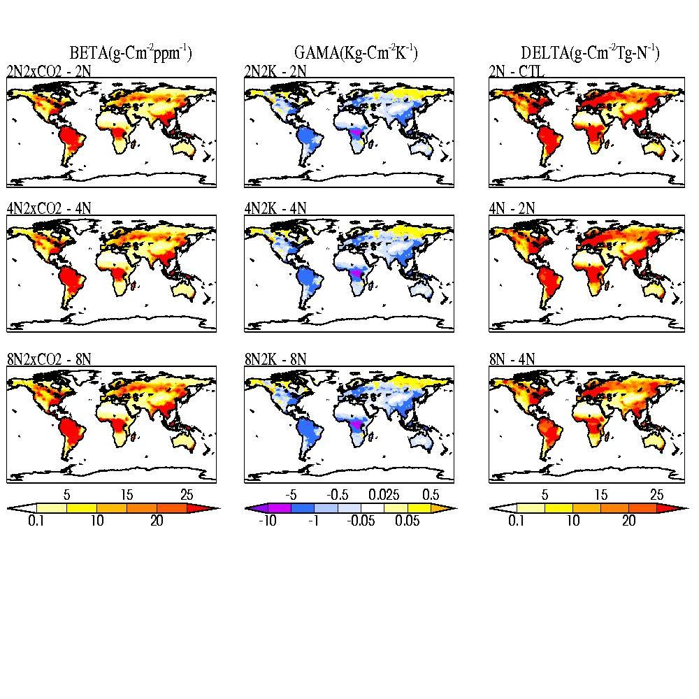
CO2 fertilization
Climate Warming
N- deposition
236 Gt-C is taken up by
terrestrial ecosystem
175 Gt-C is taken up by
terrestrial ecosystem
152 Gt-C is lost by terrestrial
ecosystem

Slide 27
EXAMPLE SCRIPTS using CDAT
# Import modules:
# cdms - Climate Data Management system accesses gridded data.
# vcs - Visualization and control System 1D and 2D plotting routines.
# os - Operation System routines for Mac, DOS, NT, or Posix depending on the
# system you're on.
# sys - This module provides access to some objects used or maintained by
#the interpreter and to functions that interact strongly with the interpreter.
import cdms, vcs, os, sys
# Open data file:
filepath = os.path.join(sys.prefix, 'sample_data/clt.nc')
cdmsfile = cdms.open( filepath )
cdmsfile.listvariables()
data = cdmsfile('clt')
# Initial VCS:
v = vcs.init()
# Plot data using the default boxfill graphics method:
v.plot( data )

Slide 28
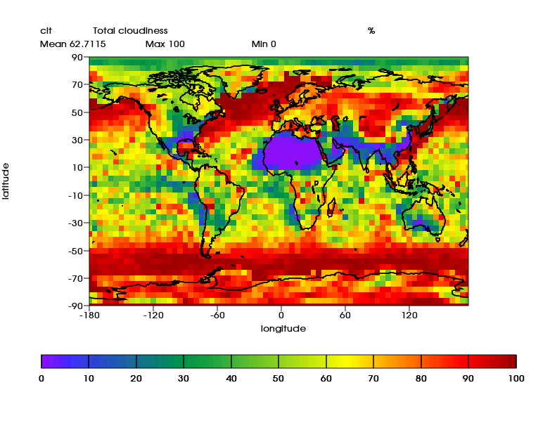

Slide 29
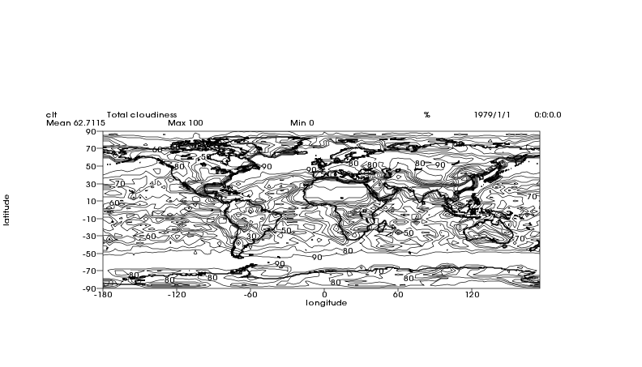
# Plot data using the isoline graphics method:
v.clear()
v.isoline( data )

Slide 30
# Extract a 3 dimensional dataset
filepath = os.path.join(sys.prefix,'/CLM4/Ncfiles/neenepnppgpp_4ndep.nc')
cdmsfile = cdms.open( filepath )
data = cdmsfile('NPP')
# Average over time and longitude to get a variable
# with latitude and level axes
d2 = cdutil.averager(data, axis='tx')
d2.id = 'NPP_zonal'
# Plot results
v.clear()
v.plot( d2 )

Slide 31
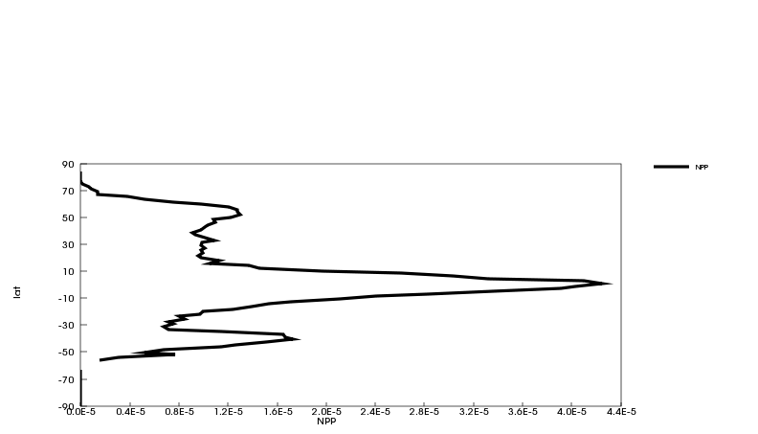

Slide 32
For time series plot
# Extract a 3 dimensional dataset
filepath = os.path.join(sys.prefix,'/CLM4/Ncfiles/neenepnppgpp_4ndep.nc')
cdmsfile = cdms.open( filepath )
data = cdmsfile('NPP')
# Average over time and longitude to get a variable
# with latitude and level axes
d2 = cdutil.averager(data, axis=‘xy')
d2.id = 'NPP_timeseries'
# Plot results
v.clear()
v.YxvsxX (d2 )

Slide 33
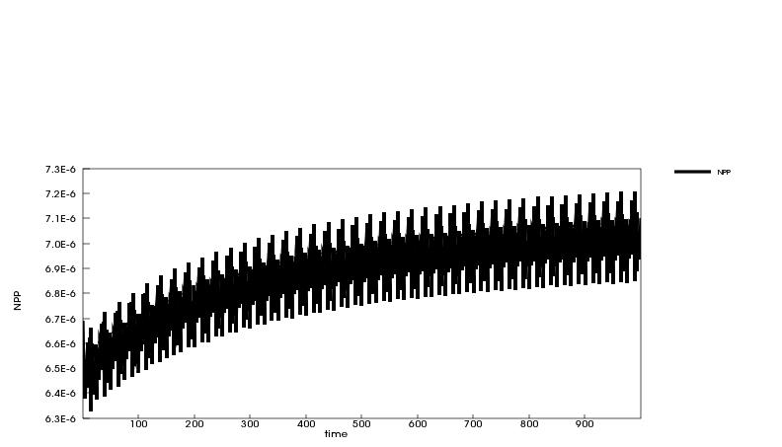

Slide 34
Program to plot/compute for a specific region:
# Extract a 3 dimensional dataset
filepath = os.path.join(sys.prefix,'/CLM4/Ncfiles/neenepnppgpp_4ndep.nc')
cdmsfile = cdms.open( filepath )
data = cdmsfile('NPP‘, latitude=(5,38), longitude=(68, 99))
# Average over time and longitude to get a variable
# with latitude and level axes
d2 = cdutil.averager(data, axis='tx')
d2.id = 'NPP_zonal'
# Plot results
v.clear()
v.plot( d2 )

Slide 35
Program to plot/compute for a specific time:
# Extract a 3 dimensional dataset
filepath = os.path.join(sys.prefix,'/CLM4/Ncfiles/neenepnppgpp_4ndep.nc')
cdmsfile = cdms.open( filepath )
data = cdmsfile('NPP‘, time=(‘0001-01-01’,0005-01-01))
# Average over time and longitude to get a variable
# with latitude and level axes
d2 = cdutil.averager(data, axis='tx')
d2.id = 'NPP_zonal'
# Plot results
v.clear()
v.plot( d2 )

Slide 36
Program to plot/compute for SEASONS:
# Extract a 3 dimensional dataset
filepath = os.path.join(sys.prefix,'/CLM4/Ncfiles/neenepnppgpp_4ndep.nc')
cdmsfile = cdms.open( filepath )
data = cdmsfile('NPP‘)
# Average over time and longitude to get a variable
# with latitude and level axes
d2 = cdutil.DJF(data) #JJA, or you can define your own seasons
d2.id = 'NPP_zonal‘
# Plot results
v.clear()
v.plot( d2 )

Slide 37
Now Calculate How much ecosystem carbon is stored in South Asia?
Calculate the effect of historical warming on South Asian Total ecosystem carbon?
Calculate the effect of historical CO2 increase on South Asian Total ecosystem carbon?
Calculate the effect of historical N deposition increase on South Asian Total ecosystem carbon?
From CAM5 simulations Calculate the effect of one million km^2 deforestation on Temperature and Precipitation for the South Asian region.

Slide 38
THANK YOU
for your attention
?

Slide 39
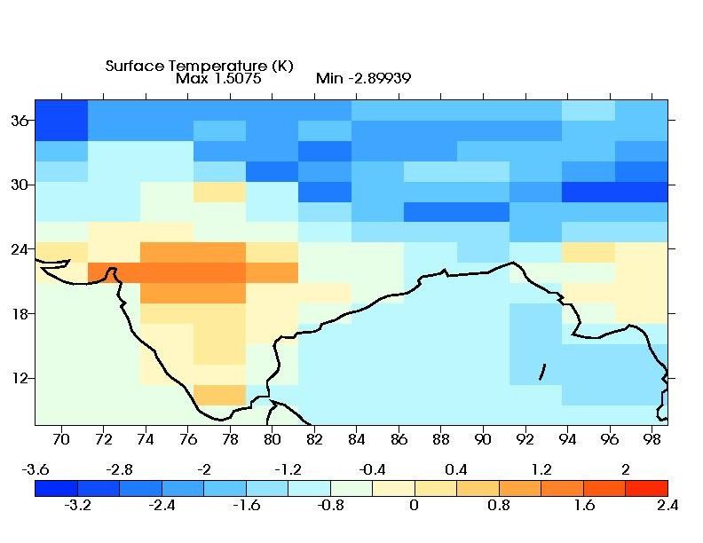

Slide 40
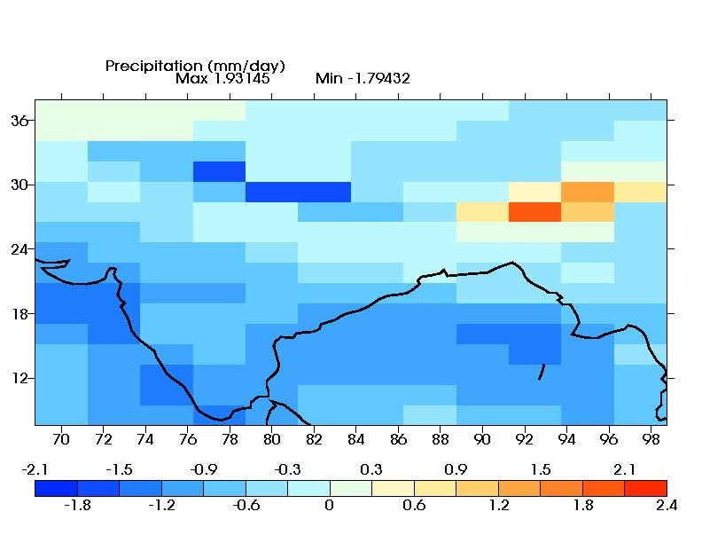

Slide 41
Scientific Questions For The Earth System Model
How will climate interactions with the Land Model influence CO2 levels in the atmosphere over the short term?
How will land use interactions with the Land Model influence CO2 levels in the atmosphere over the short term?
What role will CO2 fertilization play in controlling CO2 levels?
Will ocean biogeochemistry control the long-tem level of CO2 in the atmosphere and what will it be?
Two longer-term land wild cards: soil C release in a warmer Arctic; CH4 release in a warmer Arctic

